Slide 1
A Recommender System
Using collaborative Filtering

Slide 2



Consumer shopping experience
Old Paradigm
New paradigm
A galaxy of items
Limited to consumer’s ability and desire to drive and walk
Almost unlimited
How do you get your product in front of potential customers?

Slide 3
The solution: a Recommender System
Targets consumers with specific relevant material
Provides personalized experience
Drives user engagement
Increases sales
Improves business outcomes

Slide 4
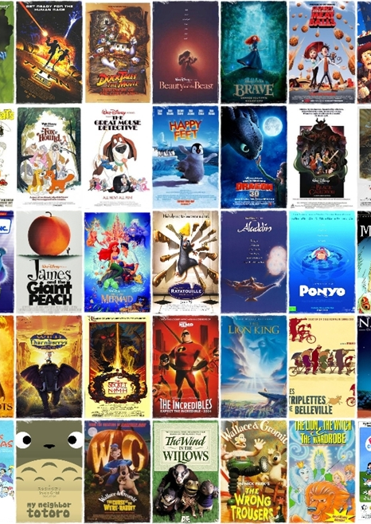
project: A recommender system for movies
2,577 films produced per year around the globe
Average person watches 20 to 30 movies a year
Old paradigm: ask a friend
New paradigm: recommender system
rotten tomatoes, taste kid, criticker, flixter, jenni, movielens

Slide 5
The Data SEt
Movielens dataset from movielens.org named “ml-latest-small”
Ratings collected between January 1995 and October 2016
10,002 ratings by 671 users on 9,123 movies
Each movie has at least 1 rating or 1 tag
Other information included: genres, timestamps, url id links
Several files are merged to create a pandas dataframe

Slide 6
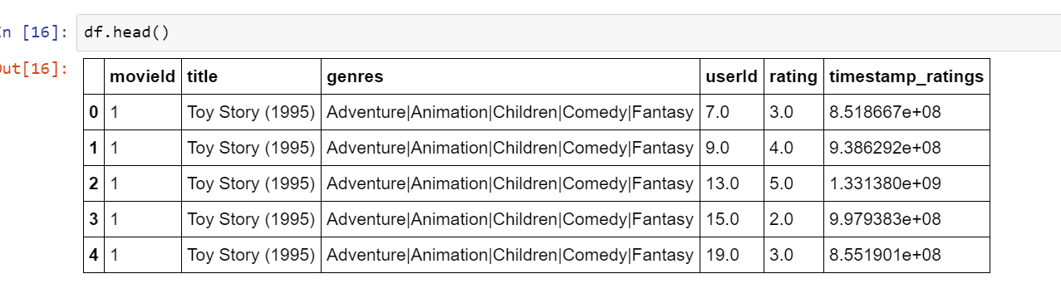
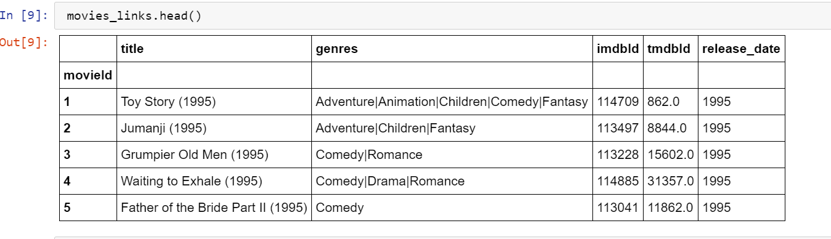

Slide 7
How to implement? Content based vs collaborative filtering
We chose Model -based Collaborative Filtering because:
No prior knowledge of user or item is required
It handles sparsity better
Scalability – model is smaller than dataset
Faster than memory-based
Can handle overfitting

Slide 8
Which algorithm?
We chose Weighted Alternating Least Squares
The nature of the dataset can determine which algorithm to use
Stanford Study compared several algorithms
ALS worked best on movie dataset

Slide 9
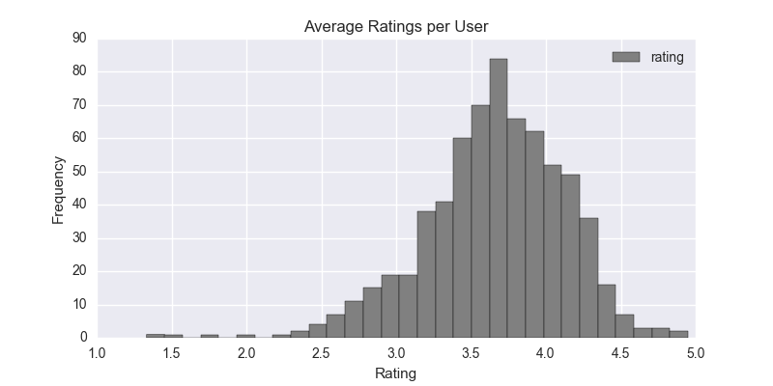
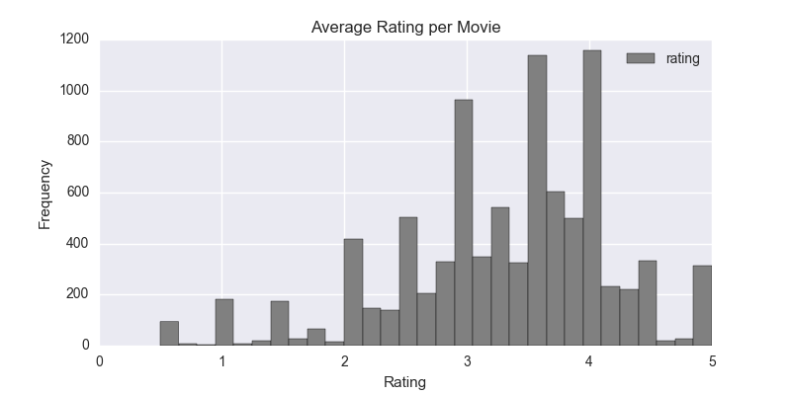
Data exploration

Slide 10
Interesting findings
Rating values range from 0.5 to 5.0 in 0.5 increments
The average number of ratings per movie is 11
The average number of ratings per user is 149
The most frequent average rating by a user is 3.8
Most popular genre is drama

Slide 11
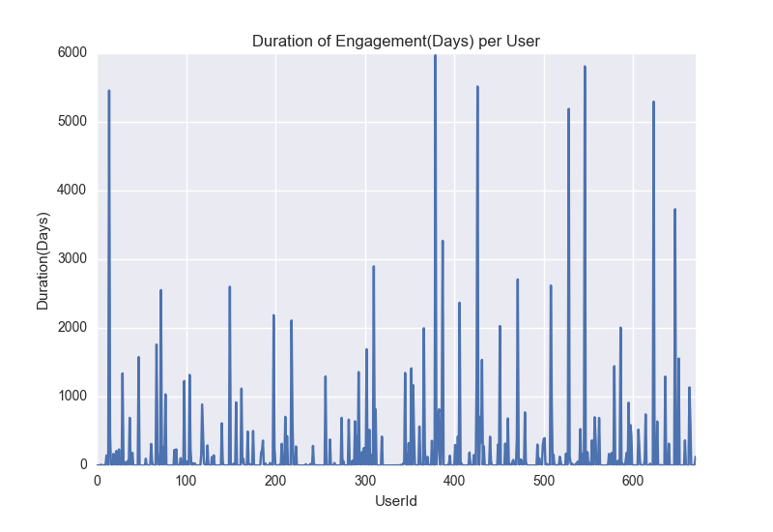
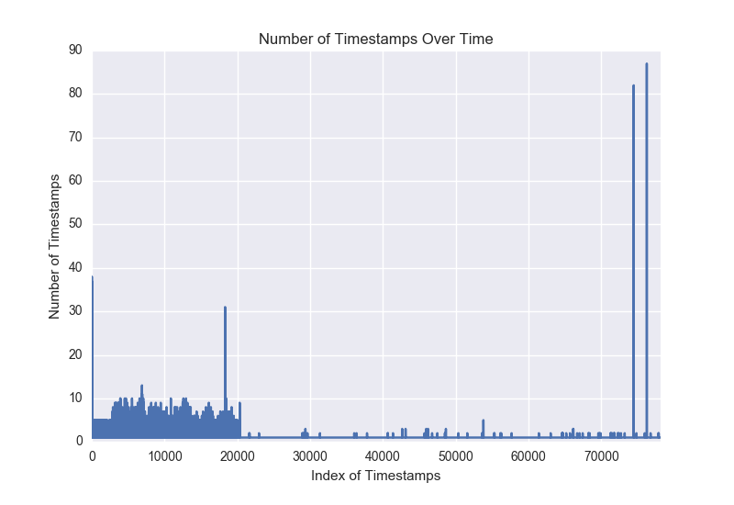
Measuring user engagement

Slide 12
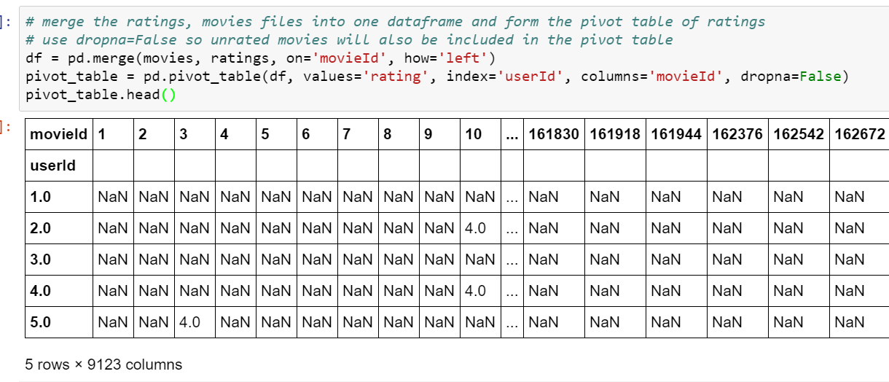
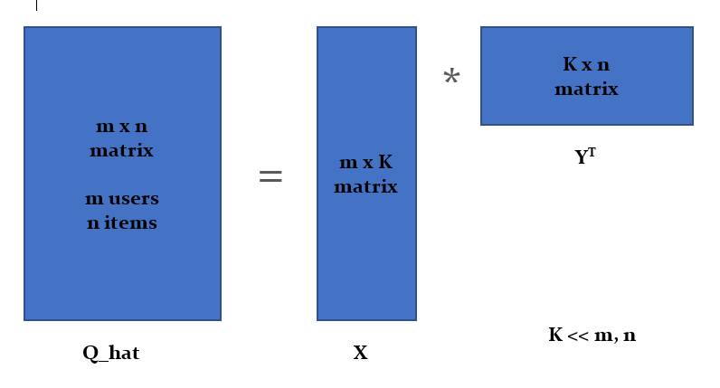
The algorithm in brief
The Q matrix of ratings
The Q_hat matrix of predicted ratings

Slide 13
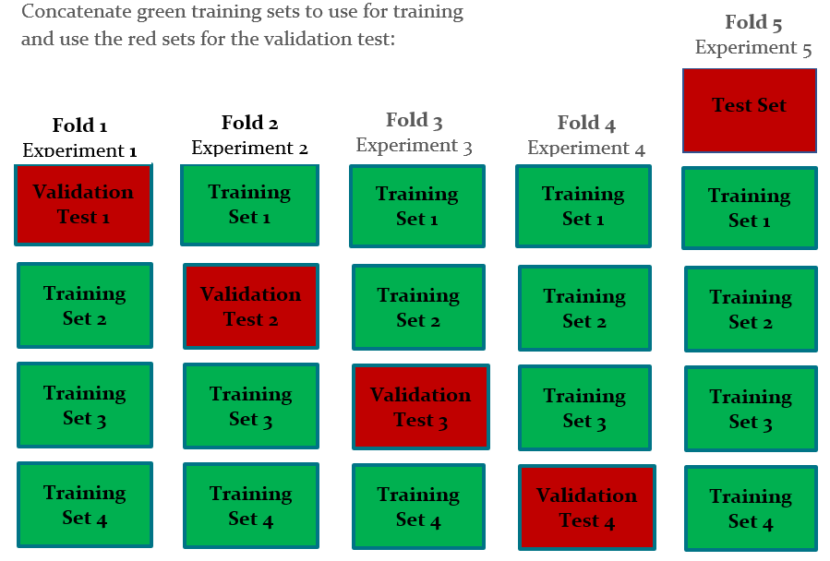
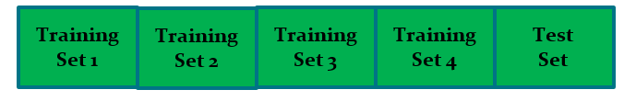
five-fold cross validation
Data Set

Slide 14
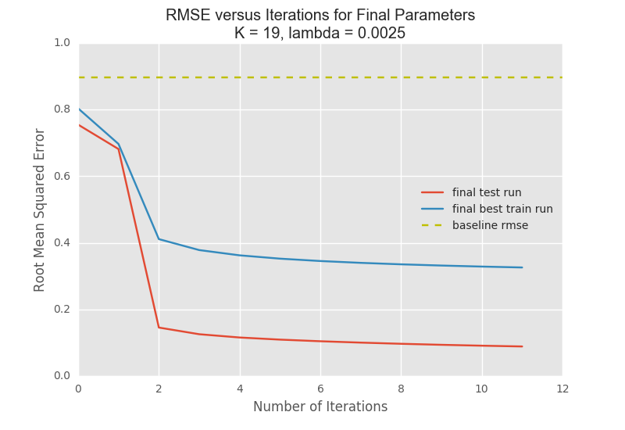
The results

Slide 15
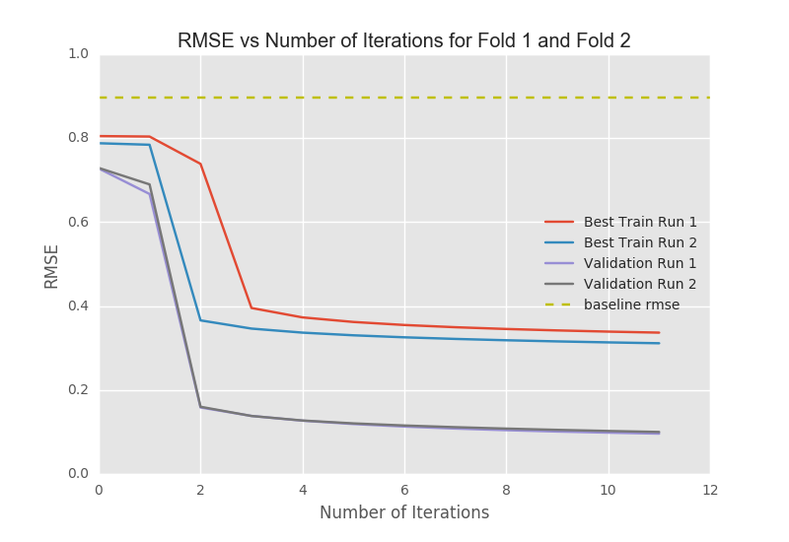
First Four Runs of Cross Validation

Slide 16
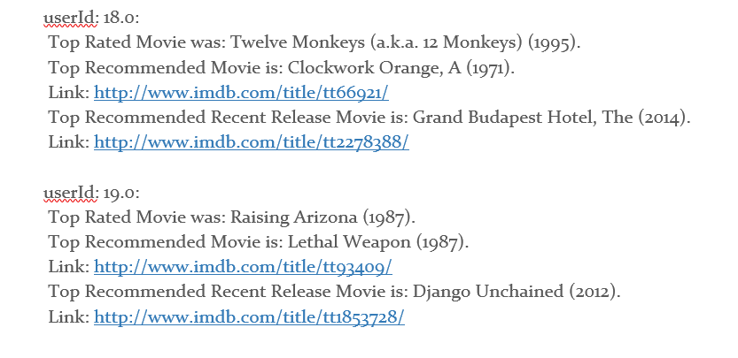
Recommender System output example

Slide 17
recommendations
Utilize hybrid approach
Use sentiment classification using tags to help predict ratings of unrated movies
Large datasets call for deep learning approach, CNN
Find a balance between computation time vs. accuracy
Output multiple recommendations

